Slide 1
UCI Heart Disease: Group C Kaggle Group Project
Alexander Toledo, Paul Phillips, Pete Chuckran, Tanner Porter

Slide 2
The dataset:
Originally collected in the early 1980’s at the Cleveland Clinic
Released by the University of California Irvine (UCI)
A collection of 13 predictors of heart disease from 306 individuals.
Response is categorical (1/0)
Heavily cited in both biology and statistics

Slide 3
The data:
Good combination of predictors with strong (ex A & B) and weak (B & C) predicting power
Slightly messy, but not too messy
Some informed data manipulation necessary

Slide 4
The data:
Good combination of predictors with strong (ex A & B) and weak (B & C) predicting power
Slightly messy, but not too messy
Some informed data manipulation necessary

Slide 5
General Approach
Two main objectives:
Find the most predictive model
Useful for diagnosis
Find the most interpretive model
Useful for research
Approach:
Try everything
Cross validate

Slide 6
Predictor Variable Selection
We bootstrapped a backward stepwise function to determine how often a variable was considered important (We called variables important if they appeared in more than 50% of the bootstrap step models).
This led to a model of the form glm(target ~ ca + cp + thal +slope, family=binomial)
We used this type of variable selection for our logistic regression model, but allowed the penalized regressors (LASSO, Ridge, Enet) to perform their own variable selection.

Slide 7
Interpretable Models
Logistic Regression → Our first consideration given the nature of our response variable (0,1)
LASSSO → Should present the most interpretable model by limiting the number of predictor variables
Ridge → Thought it would outperform the logistic regression, but perform worse than LASSO as we do not see any predictor collinearity
Elastic Net → Thought this would outperform the LASSO and Ridge due to the mixing of l1 and l2 penalties.

Slide 9
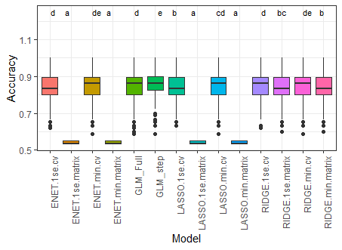

Slide 10
Predictive Models
K-Nearest Neighbors (KNN) →Utilizes “nearest” neighbors based on the relatedness of the predictor variables. Can be challenging to interpret and has extremely little interpretation in multidimensional settings.
Random Forest (RF) → Builds a number of trees instead of a single one and a split is considered for each tree. Predictive power is higher than a single tree, but the high interpretability of a single tree is lost.

Slide 11
KNN
Optimized for odd values of K between 1 and 29.
ANOVA identified no differences between 25, 27, 29.

Slide 12
KNN
Model | Mean | SD | Median
KNN_29 | 0.84758793 | 0.06257553 | 0.86206897
KNN_27 | 0.84603793 | 0.06272565 | 0.86206897
KNN_25 | 0.84338908 | 0.06309142 | 0.83333333
KNN_23 | 0.83436897 | 0.06441043 | 0.83333333
KNN_19 | 0.83233563 | 0.06567952 | 0.83333333
KNN_17 | 0.83176264 | 0.06686321 | 0.83333333
KNN_21 | 0.82898161 | 0.065714 | 0.83333333
KNN_15 | 0.82762299 | 0.06559657 | 0.83333333
KNN_13 | 0.82722874 | 0.06559187 | 0.83333333
KNN_5 | 0.82567414 | 0.06576056 | 0.82758621
KNN_7 | 0.81673966 | 0.06628546 | 0.82758621
KNN_9 | 0.81549828 | 0.06540028 | 0.82758621
KNN_11 | 0.81483908 | 0.06526156 | 0.82758621
KNN_3 | 0.80276552 | 0.06429197 | 0.8
KNN_1 | 0.71037701 | 0.07455258 | 0.72413793

Slide 13
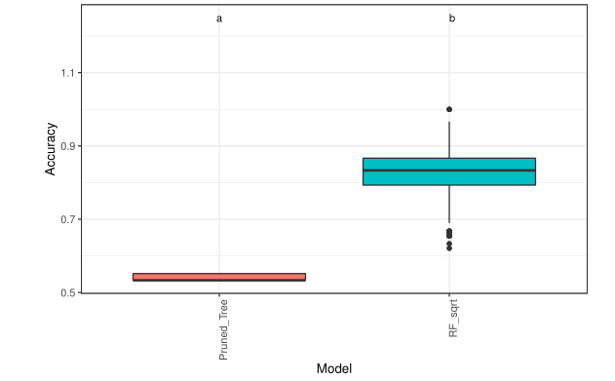

Random Forest and Pruned Tree Comparison
A single pruned tree vs 1000 trees
Left mtry as the default of $\sqrt{p}$
randomForest has a function tuneRF for tuning mtry

Slide 14
Random Forest and Pruned Tree Comparison
Model | Mean | SD | Median
Pruned Tree | 0.5406897 | 0.0090119 | 0.5333333
Random Forest | 0.8286270 | 0.0629306 | 0.8333333

Slide 15
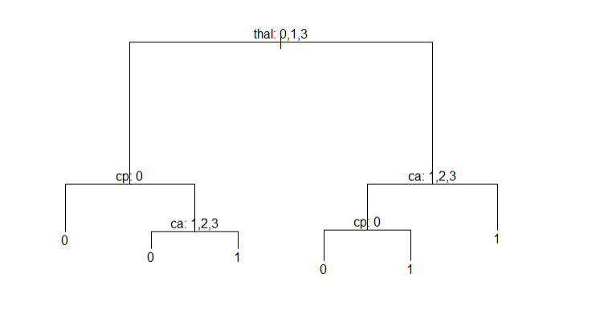
Pruned Tree
Used deviance to check the best number of leaves
Best size was 6

Slide 16
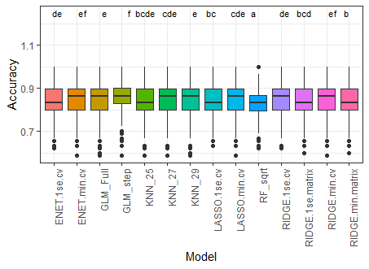

Slide 17
Overall
We recommend utilizing the logistic regression model that contains minimal predictor variables.
This model has the highest median accuracy over 200 iterations
This model also has the smallest deviations around that mean.
Finally this is one of the more interpretable models we can generate through analyzing odds ratios.

Slide 18
LOGISTIC = glm( target ~ cp + ca + sex + slope + thal, data=Heart)
Coefficients: Estimate Std. Error t value Pr(>|t|) (Intercept) 0.68229 0.10737 6.354 7.85e-10 *** cp 0.15246 0.02151 7.089 9.90e-12 *** ca -0.12840 0.02168 -5.922 8.79e-09 *** sex -0.20024 0.04743 -4.222 3.22e-05 *** slope 0.21189 0.03536 5.993 5.96e-09 *** thal -0.15181 0.03671 -4.135 4.62e-05 ***
target ~ 0.68 + 0.15cp -0.12ca -0.2sex + 0.2slope -0.15thal, data=Heart)

